Slide 1
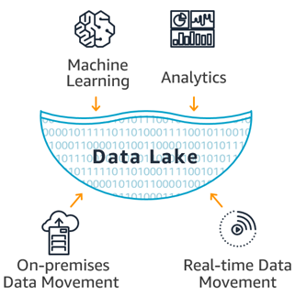
Holistic Lab Execution Environment Data Processing With ENTERPRISE DATA LAKE ON ELASTIC PLATFORM
Akza John
Roll No - 04

Slide 2
Topic
The Holistic Lab Execution Environment data processing with Enterprise Data Lake focuses on experimental data of a pharmaceutical company and perform transformations on data. The Holistic Lab Environment is a client-server based system that allows research scientists that work with Good Lab Practices data to store their experiment data and content in a central repository. The amount of data generated in Holistic Lab Execution Environment (HLEE) labs will be huge and real streaming.

Slide 3
AREA
Big data analytics applications enable big data analysts, data scientists, predictive modelers, statisticians and other analytics professionals to analyze growing volumes of structured transaction data, plus other forms of data that are often left untapped by conventional BI and analytics programs.
Enterprise Data Lake (EDL) is a large repository for many different types and sources of data, they can be structured or unstructured, internal or external, to facilitate different ways of accessing and analyzing the data.

Slide 4
Technology
Different key resources used by the system are Airflow, Databricks, Amazon S3, CloudWatch, Kibana, GIT repository.
The HLEE data processing with EDL 2.0 stores data in the form of json format, and for the further analysis, each data will be extracted and finally it will be stored in Postgres database and Redshift database
To provide reports on visualization tools including custom made user interfaces, Reporting tools like TIBCO Spotfire and Tableau.

Slide 5
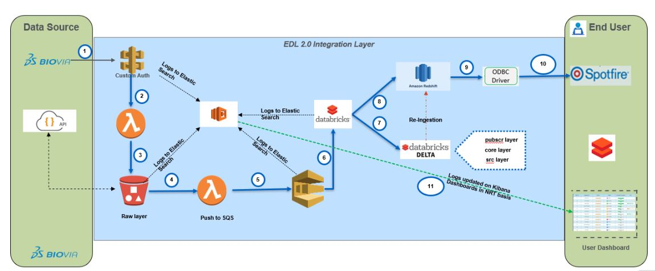
ARCHITECTURE OF HLEE 2.0

Slide 6
Architecture explanation
Databricks Notebook polls the web services in order to get the data and Lambda function will push the json data by compressing it to S3 bucket
The compressed zip files will be pushed to SQS by Lambda function and then to Databricks Notebook which contains parser to parse the Json dataLogging will be stored to Elastic Search of all the stages
Kibana is the visualization tool where the status of HLEE will be checked
All the data will be parsed from Databricks Notebook to the Databricks Delta which stores all the data and only the required data to redshift.
Then the data present in Databricks Delta, is copied to the Src table with all the old and new version json data.

Slide 7
Architecture explanation
The Latest version Src table data is transformed to the Core table which is in Sync with Redshift
The old data which is present in Redshift will be deleted when Dags are generating everyday.
The data which is present in the Databricks Delta will be reingested to Redshift.
The Redshift is connected to Spotfire via ODBC connectionThe Core layer data will be moved to PubSrc layer where the user can see the data in views

Slide 8
Modules
1. HLEE Taskplan
A HLEE Task Plan is a collection of Tasks to be performed in a laboratory. Task Plans facilitate management of work in a scientific process.The owner of a Task Plan is typically a scientist or a laboratory manager (HLEE User), who assigns tasks to coworkers such as laboratory technicians.Hlee Users will get reports through spotfire in tabular format or any other graphical format.A taskplan report may constitute of task id,activity,due date,life cycle state requested group, completion date,assignee etc

Slide 9
Modules
2. HLEE CNC
EDL will continuously ingest HLEE C&C data from Compose and Capture system with a max time gap of 15 minutes from the time the recipe message is available for ingestion by EDL, where the maximum size of the recipe message is up to 10 MB. The fetched data will be processed and loaded into EDL. Logs are created containing at least the following information:
Recipe ID, Status, Timestamp
User will search for the desired HLEE C&C recipe and access the HLEE C&C recipe data for analysis in Spotfire from the database via ODBC.
The latest version of the HLEE C&C recipe captured execution data available in EDL is displayed to the user via Spotfire.

Slide 10
Requirements
Configuration Files
Setting up for environment files
Authorisation token
Database Connection Creation
Creation of Lambda constant files
Creation of Lambda python files

Slide 11
Current status
Stages | Status
Understanding the system | Completed
Get familiar with various technologies used in the system | Completed
Learn to monitor HLEE data in Kibana and CloudWatch | Completed
HLEE taskplan module | Progressing
HLEE compose and capture module | Pending
HLEE workbook module | Pending

Slide 12
Conclusion
The Holistic Lab Execution Environment is a client-server based system that allow scientists that work with GxP data to store their experiment data and content in a central repository. The system allows experiments to be published electronically and routed for peer review and sign off. Experiment data and content can also be searched and linked into other experiments. This will provide a searchable knowledge-base of pharmaceutical companies scientific information.

